Slide 1
Welcome

Slide 2


PYTHON PROGRAMMING LAB (22CS001)
DEPARTMENT OF COMPUTER SCIENCE & ENGINEERING Chitkara University, Rajpura (Punjab)
Submitted To: Dr. Harveen Kaur Asst. Prof. CSE
Submitted By: Keshav(2210990502),
Krithik Saini(2210990522),
Khushi Verma(2210990514).
Group Name/no. : G-25(3)

Slide 3

Contents
Project details
Who’s Who
Who Does What
Introduction
What’s More
Scoring
About Questions
Concept Clarification
Topics of working
Advantages
Future scope
Our Big Vision
Role Of Python In Games.
14. Games Developed By Python
15. Conclusion

Slide 4

PROJECT DETAILS :
Project Name : KBC -
Kaun Banega Codepati
Programming Tool :
Python
Our Team :
Keshav, Krithik Saini,
Khushi Verma
HELLO!
4

Slide 5

Who’s who!
Keshav (2210990502) – Coder Team Leader
Krithik Saini (2210990522)- Coder1
Khushi Verma (2210990514)- Coder2
5

Slide 6


Who Does What?
Coder 1 :
selected the questions for the game according to the level & helped in preparing the presentation.
Team Leader : overviewed the overall working and basic idea of the project & prepared the code.
Coder 2 :
logic building for coding & selected the questions for the quiz .

Slide 7

Feeling Bored? Wanna play a game that will enhance your knowledge without wasting your precious time?
How about KBC? No.. It’s not what you think!
Well, Hello all the coding freaks out there, we have an interesting game for you that will test your knowledge about python and some general knowledge.
7

Slide 8
What’s More..?
This application is developed for educational-cum-entertainment purpose, allowing the users to increase their general knowledge about coding and in a fun way. Our quiz application will offer the player questions which the player has to respond to with a correct answer. Player can quit the game anytime if he/she wants to do so. Total points will be given at the end of the game.
“knowledge becomes power only when we put it into some use”

Slide 9
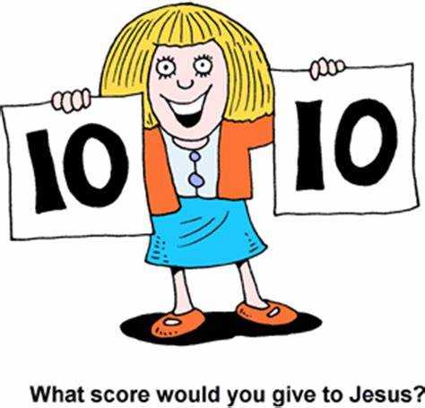
1 point will be given for each correct answer. There will be 2 chances given for every question, after two chances one point will be deducted as penalty. Player can also skip the question if needed and no points will be deducted for skipping the questions.
Scoring in KBC

Slide 10

Level of Questions
In the beginning easy questions will be asked. As the player moves ahead the level of the questions will increase. The questions are designed in a way that even if you have a basic knowledge about coding and general knowledge you can still play this game.
10

Slide 11

Concepts Used
We have used a basic concepts of python like lists, tuple and loops like for, if, else.
11

Slide 12
Topics of working
Our application covers information about python and what’s going on around us
here are a few questions at glance.
Q1. What is the extension of python?
Ans. .py
Q2. which character is used to give a single line comment?
Ans. #.
Q3. Which is the biggest animal on earth?
Ans. Blue whale.

Slide 13
Advantages of our App :
User- friendly
Educational
Fun- learning
Judicious use of free time
Improves thinking skills
Stimulates cognitive thinking

Slide 14
Our Big Vision
This app is best suited for coding aspirants or for someone from a non-coding background who wants to step into the world of Python and wants to increase their basic general knowledge and python skills. This app strengthens your basic knowledge related to Python. For someone who wants to grow in this field needs to get his fundamental concepts clear and this app offers learning them in a fun way!

Slide 15

Future Scope
With time, we can modify various aspects of this app like sound effects, visuals, level of questions, number of questions, etc. Various modes can also be incorporated for people who would like to play advance-level quiz about Python.

Slide 16

Advantages Of Using Python In Games
Game development in python is a pretty easier task than doing the same in Java or C++. Python has libraries which help a lot in this process. Its concise, human-readable syntax and built-in interpreter make Python an optimal choice for anyone new to programming. Its platform independence, and high-level design ensure versatility and increase developer productivity

Slide 17
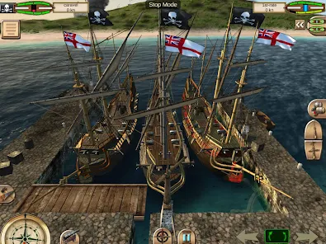
Other Games developed using python
Pirates Of Caribbean

Slide 18

EVE Online

Slide 19

Conclusion:
In the fast growing field of software engineering and development and even more rapidly growing sector of game development the future is hard to predict. We are working with this game as our software project as part of our degree we choose the type of work for doing better with development cycle, development period, graphics, sorting, adopting new technology, animation.

Slide 20
Special mention
We want to specially thanks our mentor Dr. Harveen Kaur who approved our project and enlightened our way so we could complete our project. Here we are with our project.

Slide 21


